Slide 1

Introduction to RL – Part 2
TA. Bogyeong Suh
Machine Learning &
Control Systems Lab.

Slide 2
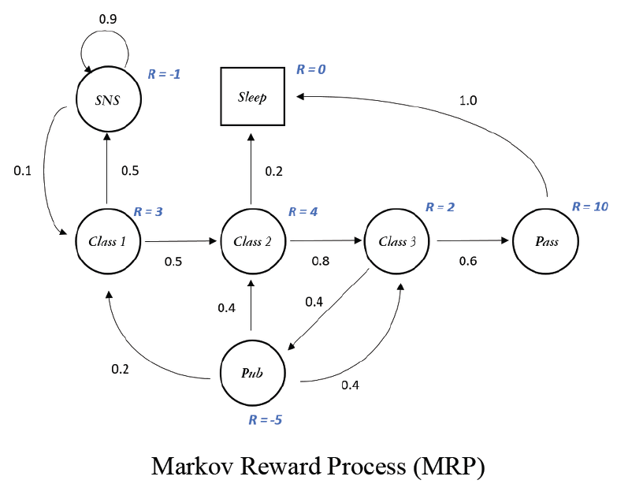
Recap of Part 1
Markov Decision Process
The process of RL is usually given as Markov Decision Processes (MDPs), which is a mathematical framework used for modeling decision making in situations where the outcomes are partly random and partly under the control of a decision maker.

Slide 3
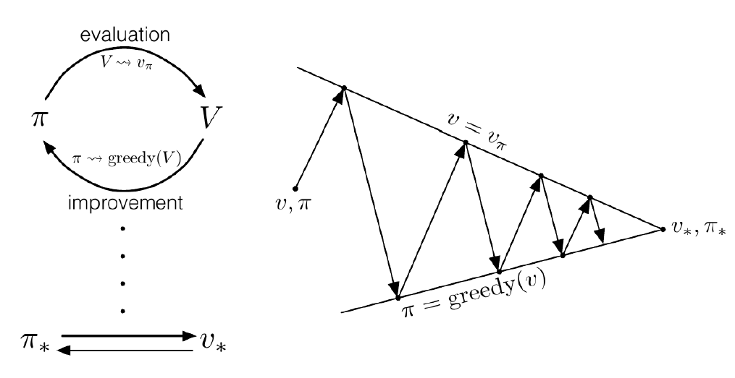
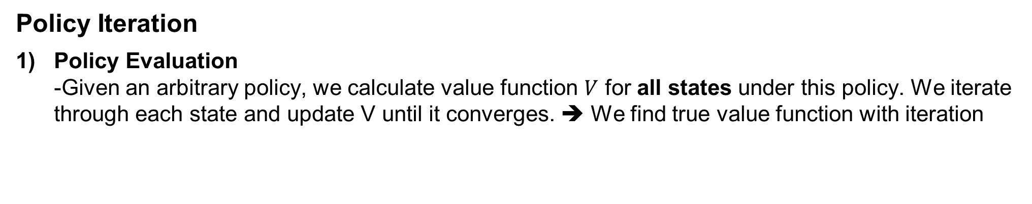
Recap of Part 1
Policy Iteration
Policy Evaluation -Given an arbitrary policy, we calculate value function $V$ for all states under this policy. We iterate through each state and update V until it converges. ➔ We find true value function with iteration

Slide 4
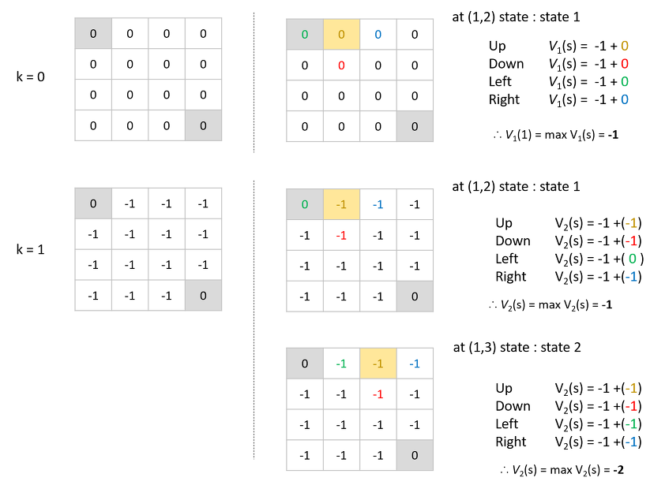
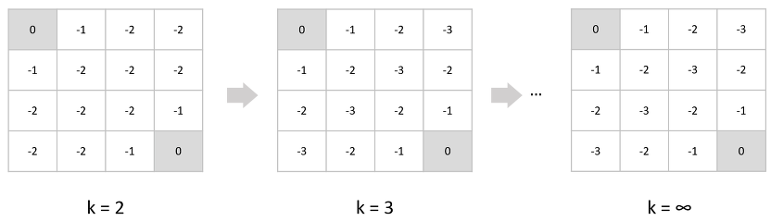
Recap of Part 1
Value Iteration

Slide 5
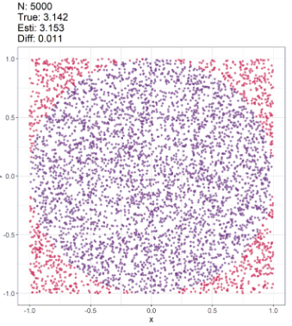
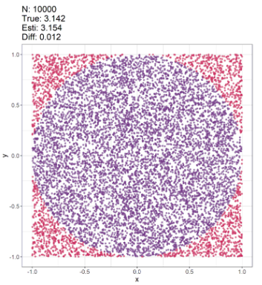
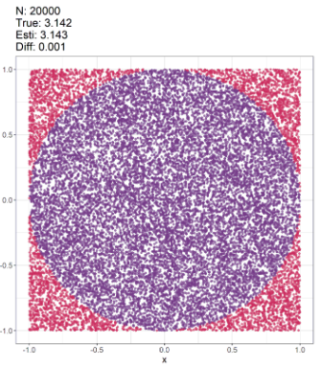
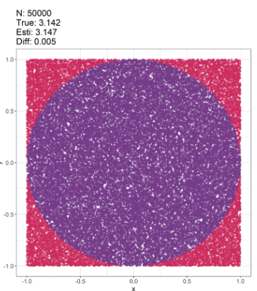
Monte Carlo method
Monte Carlo method
Generally, MC is a method that relies on repeated random sampling to obtain numerical results
MC methods learn directly from episodes of experience
In MC, we learns from complete episodes: no bootstrapping
MC is model-free: no knowledge of MDP transitions / rewards
e.g. Finding the area of a circle with radius=1 using random samples of (x,y)

Slide 6
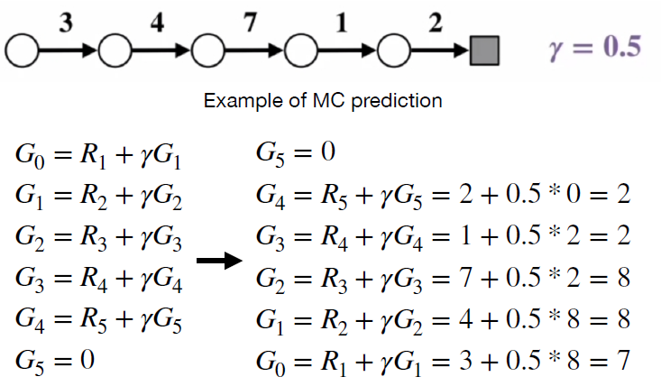
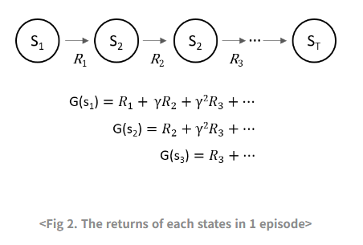

Monte Carlo method
Monte Carlo method
Goal: learn a policy that maxmimizes the total cumulative reward it receives over time
Transition probability: $p\left(s^{′}, r | s, π\left(s\right)\right)$
State Value function: $V_{π}\left(s\right)=𝔼_{π}\left[G_{t} | S_{t}=s\right]$ →Average values of returns from episodes
Action value function: $q_{π}\left(s,a\right)=𝔼_{π}\left[G_{t} | S_{t}=s, A_{t}=a\right]$

Slide 7
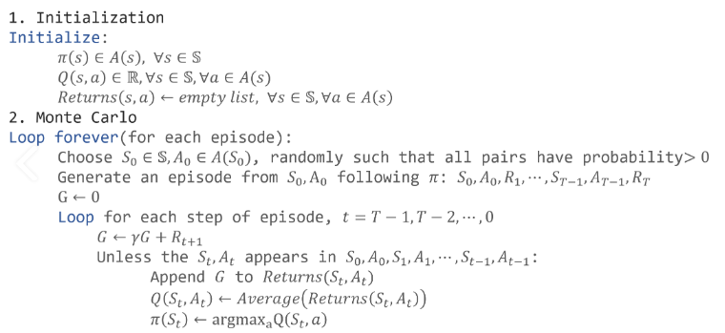

Monte Carlo method
Monte Carlo method
Using randomly generated episodes, calculate action value function from cumulative reward $G$ $q_{π}\left(s,a\right)=\frac{1}{N\left(s\right)}\sum_{i=1}^{N(s)}{G_{i}(s)}$
- $N\left(s\right)$: number of times we visited state s we from start to end in total episodes
$G_{i}(s)$: return of state $s$ in episode $i$

Slide 8
Temporal Difference Learning
Comparison of DP and MC
Dynamic Programming
- Pros: bootstrapping (update value estimates based on other learned estimates, without waiting for a final outcome)
- Cons: Model-Based (requires complete and accurate model of the environment)
Monte Carlo method
- Pros: Model-free (learn directly from experience)
- Cons: applicable to episodic tasks (require episodes to end to calculate returns, making them unsuitable for continuous tasks)
➔ Temporal Difference Learning (TD) takes advantages from DP and MC; It is model-free (uses random sampling), which learns directly from raw experience without a model of the environment, and bootstraps by updating estimates based in part on other learned estimates, without waiting for a final outcome.

Slide 9
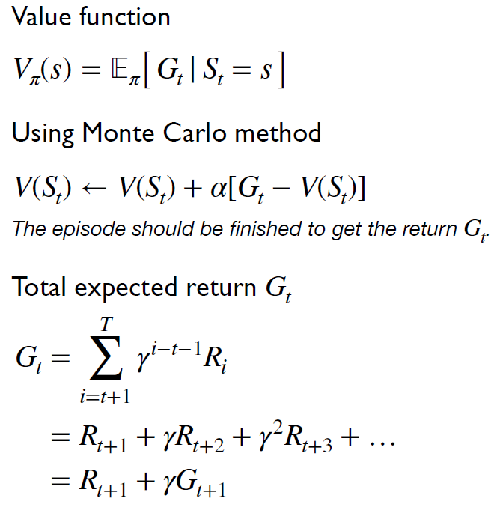
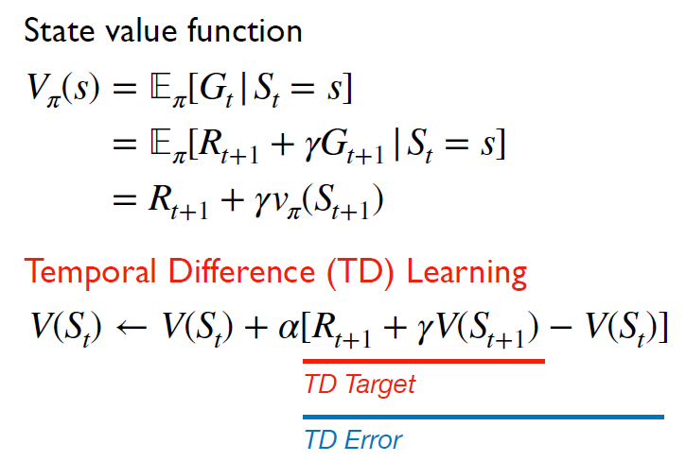
Temporal Difference Learning
Temporal Difference Learning
Estimated value of the current state
- It updates the value of the current state towards the estimated return
- TD error: measures the difference between the predicted value of the current state and the observed reward plus the estimated value of the next state

Slide 10
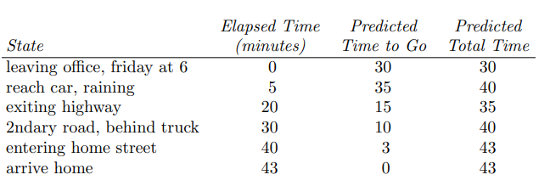
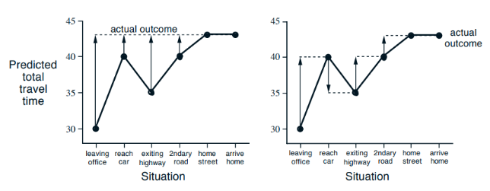
Temporal Difference Learning
Temporal Difference Learning
Monte-Carlo method
Temporal Difference learning

Slide 11

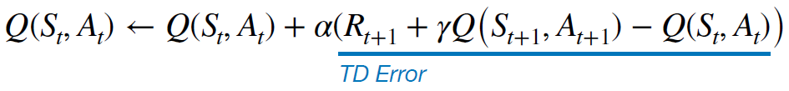
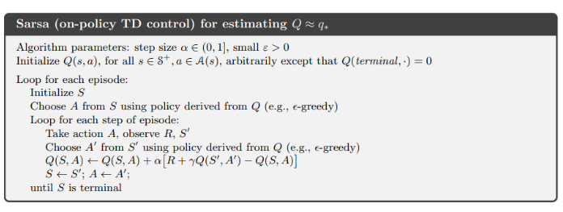
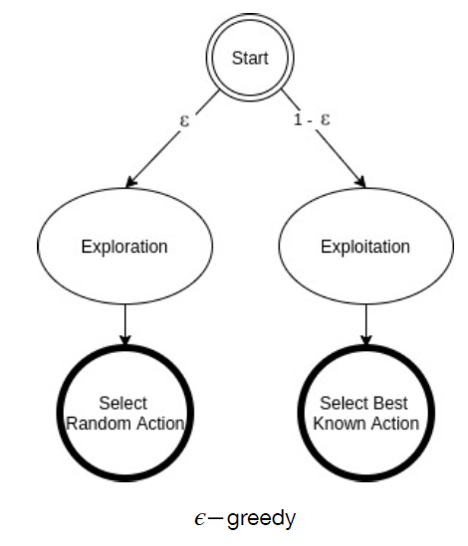
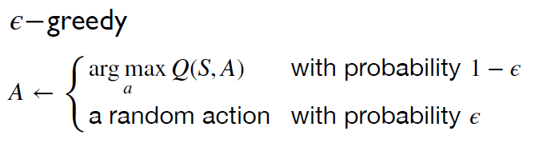
SARSA
SARSA
-On-policy TD control

Slide 12
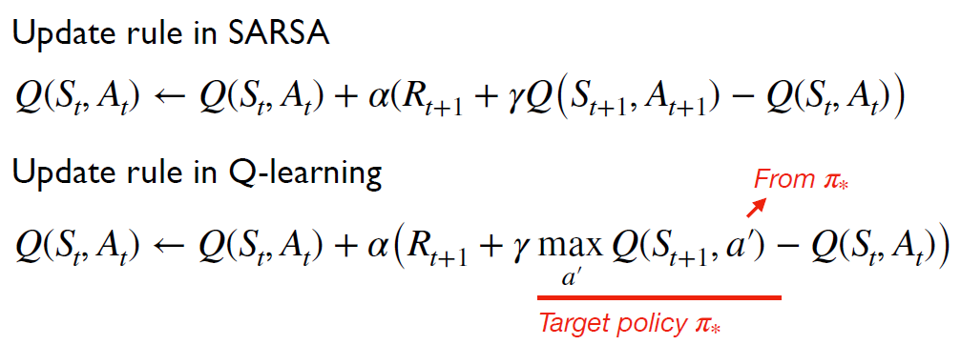
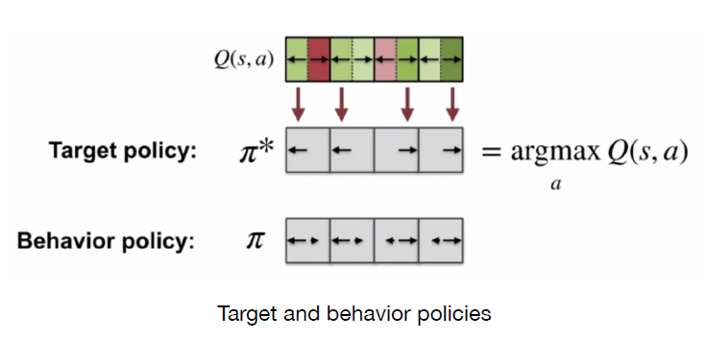
Q-learning
Q-learning
-Off-policy TD control

Slide 13
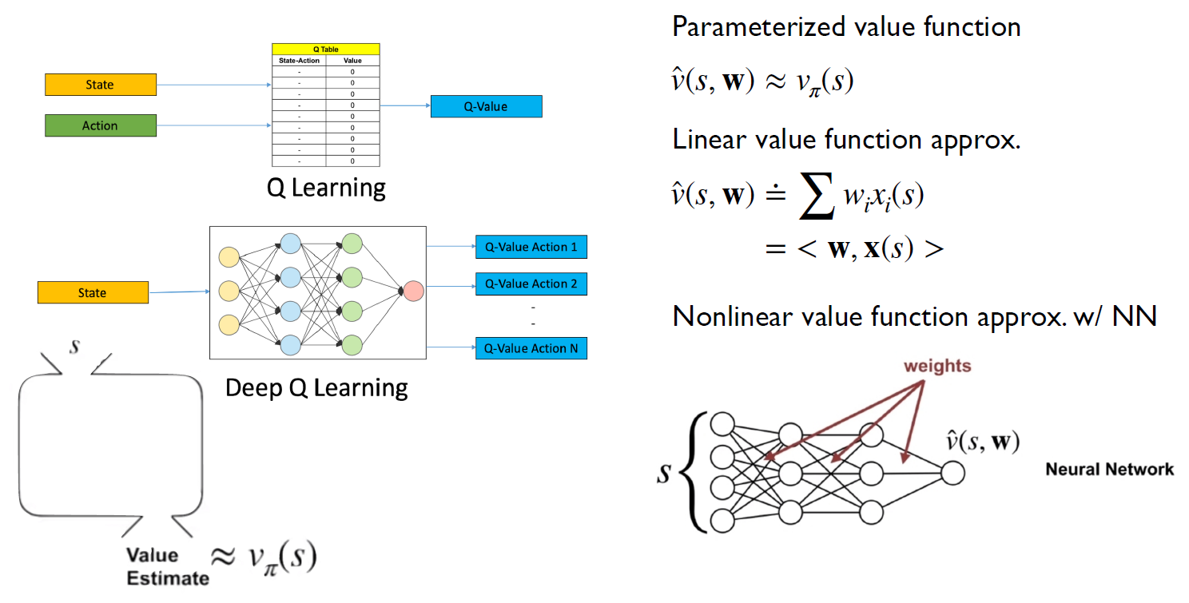
Deep Q-learning
Deep Q-learning
-d
-change of data distribution may lead to oscillation and uncertainty during training and result in local minimum convergence

Slide 14
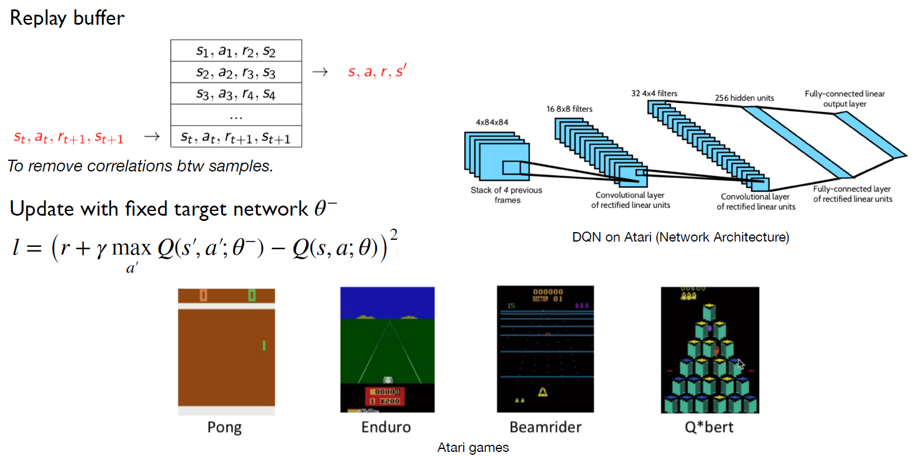
Deep Q-Networks (DQN)
Deep Q-Networks (DQN)
-experience replay and target network resolves the problem of Deep Q-learning

Slide 15
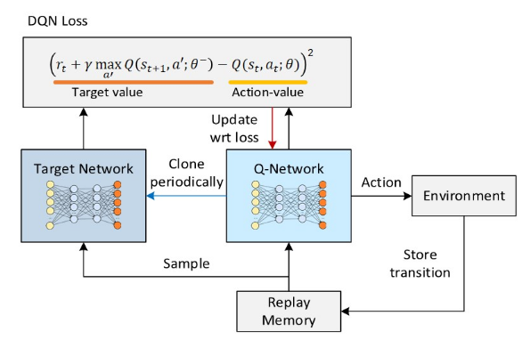
Deep Q-Networks (DQN)
Deep Q-Networks (DQN)
- Target network

Slide 16
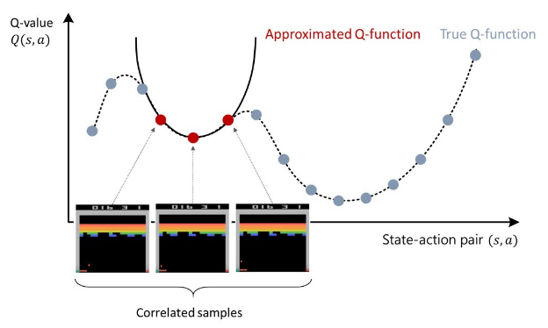
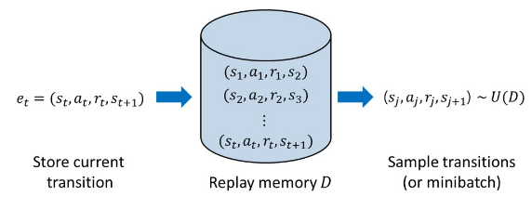
Deep Q-Networks (DQN)
Deep Q-Networks (DQN)
- Experience replay
- Target Network

Slide 17
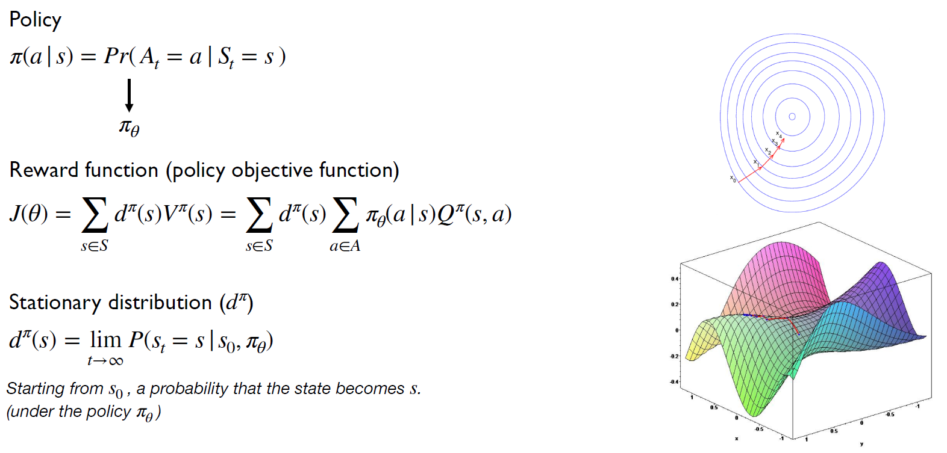
Policy Gradient Theorem
Policy Gradient Theorem

